Slide 1
EasyReg
M3 - Prototype
Universidade de Aveiro - DETI - April 2025
1

Slide 2

EasyReg aims to simplify and automate compliance tracking, ensuring organizations meet their security obligations efficiently
2

Slide 3
Table of Contents
01
02
03
04
Context
State of the Art
Requirements
Actors
05
06
07
Architecture
Demo
Calendar
3

Slide 4
Context
Multiple Compliance Requirements
Organizations need to work across multiple frameworks, each with its own compliance requirements, resulting in significant complexity in managing the process.
Need for an Integrated Solution
There is a demand for a centralized platform that automates the tracking and management of requirements, optimizing workflows and ensuring security.
Manual Processes and Risks
Manual evidence collection and audit execution increase the risk of inconsistencies and errors, while also requiring significant operational effort.
4

Slide 5
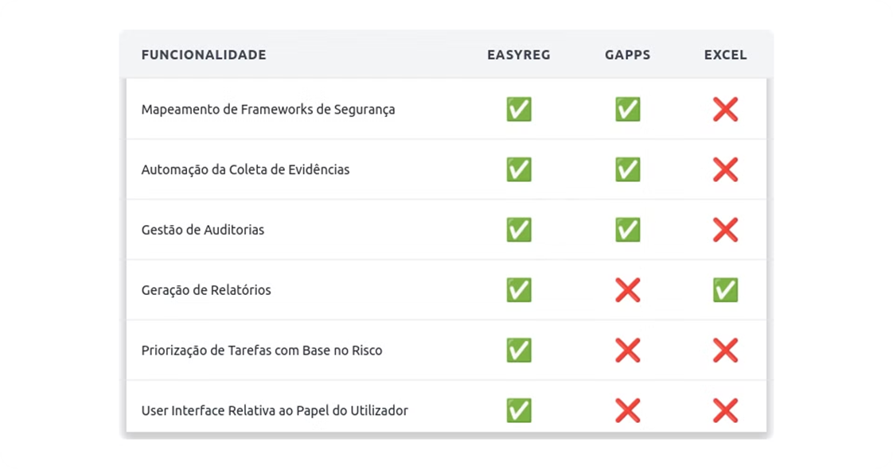
State of the Art
5

Slide 6




Functional Requirements
Authentication, Authorization and Security
Audits Management
Accessible Evidences
Compliance Information
6

Slide 7




Actors (initially)
Admin
Internal Auditor
with 6 User Stories
with 2 User Stories
Contributor
with 5 User Stories
Company Owner
External Auditor
with 7 User Stories
with 3 User Stories
7

Slide 8
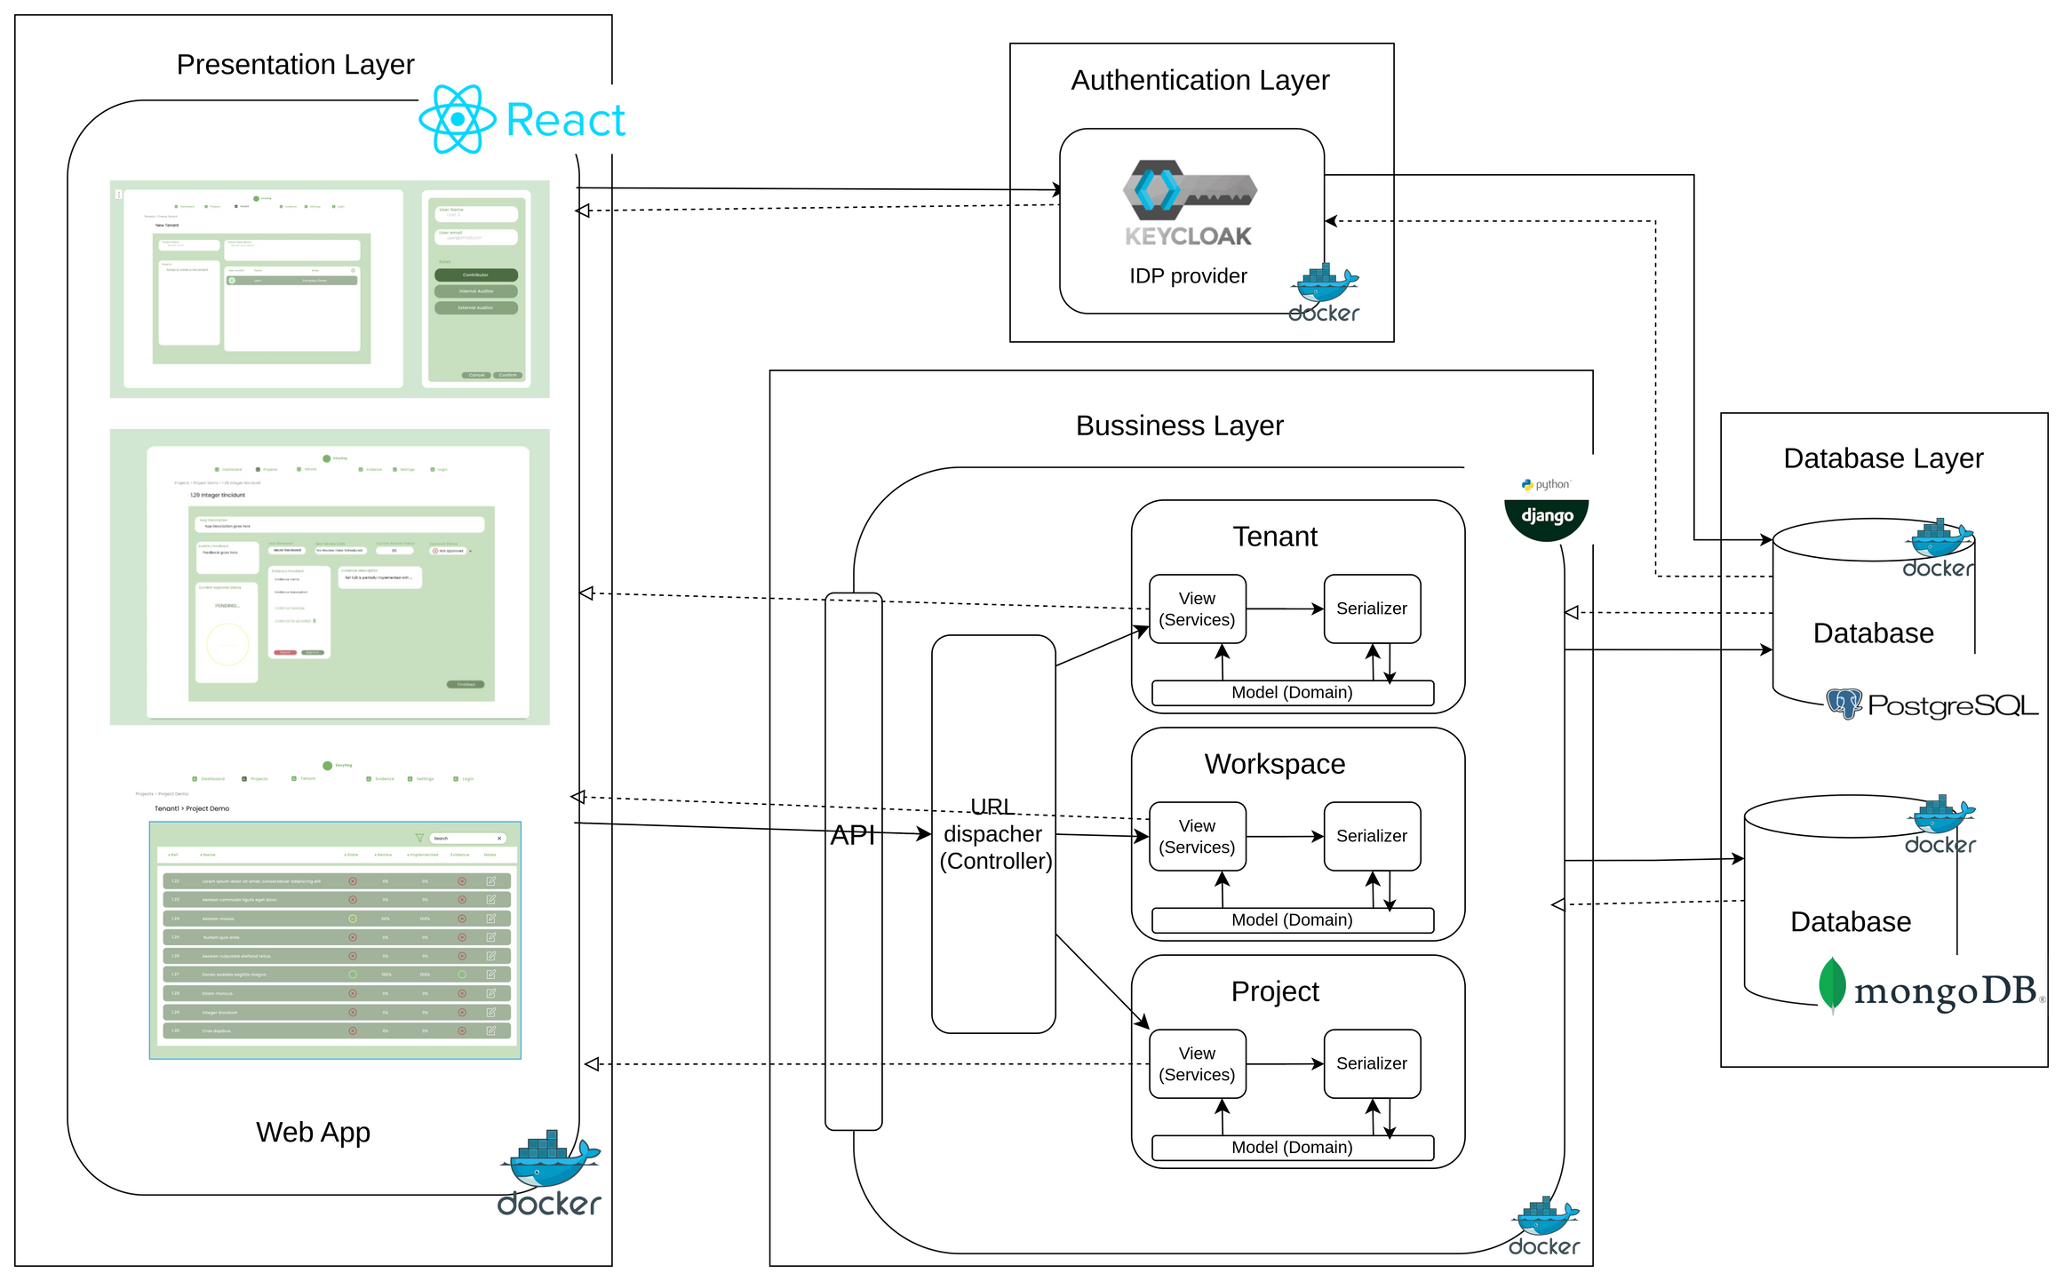
Architecture
8

Slide 9

Demo
9

Slide 10
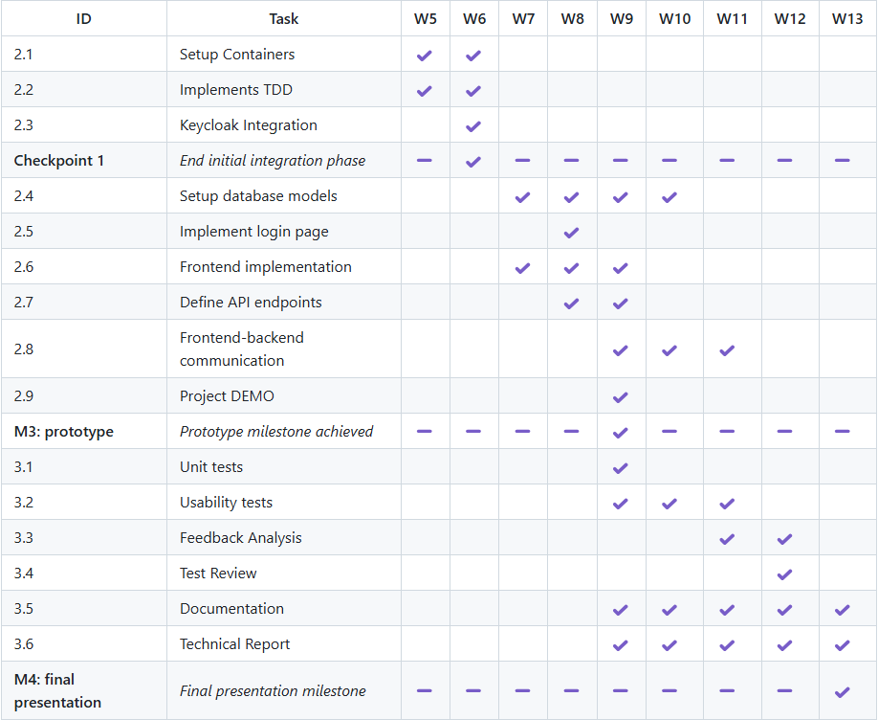
Calendar
10

Slide 11
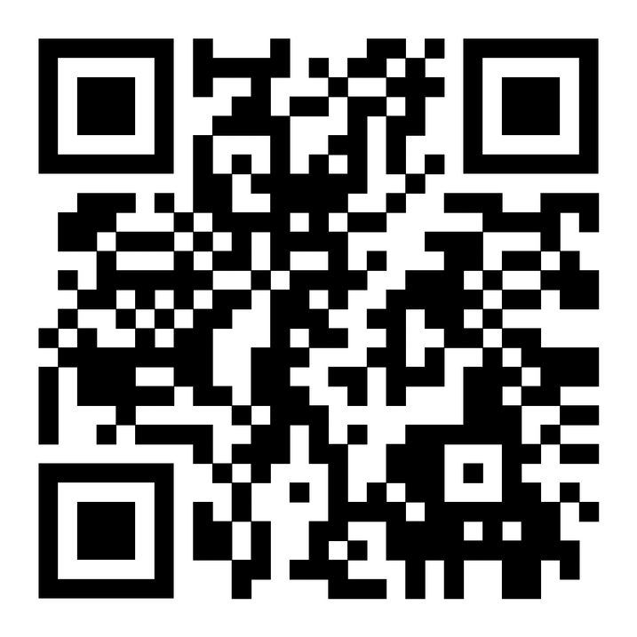
Micro-Site
Thank you!
11

